Slide 1
Bayesian Learning
Naïve Bayes & co.

Slide 2
Probabilistic Learning
Important distinction
modeling the probability of class memberships given input data → discriminative model
make a probabilistic model of data within each class → generative model
A non probabilistic model is considered discriminative (look for discrimination class given the data)

Slide 3
 | Probabilistic | Non-Probabilistic
Discriminative | Logistic Regression Neural Networks (soft-max) …….. | K-NN Linear classifier Decision Tree ……
Generative | Naïve Bayes Model-based (e.g., Bayesian Networks) ……

Slide 4
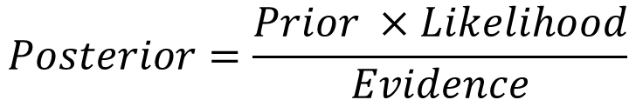
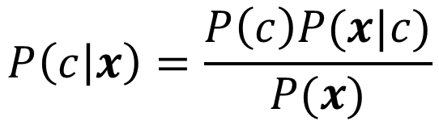
Bayes Rule
Generative
$$P\left(c | x\right)=\frac{P\left(c\right)P(x|c)}{P(x)}$$
Discriminative
$$Posterior=\frac{Prior ×Likelihood}{Evidence}$$

Slide 5
Discriminative model
Discriminative
Probabilistic Classifier

Slide 6
Generative Model
Generative
Probabilistic Model
for Class 1
Generative
Probabilistic Model
for Class L
Each is trained on only the examples of the same label

Slide 7

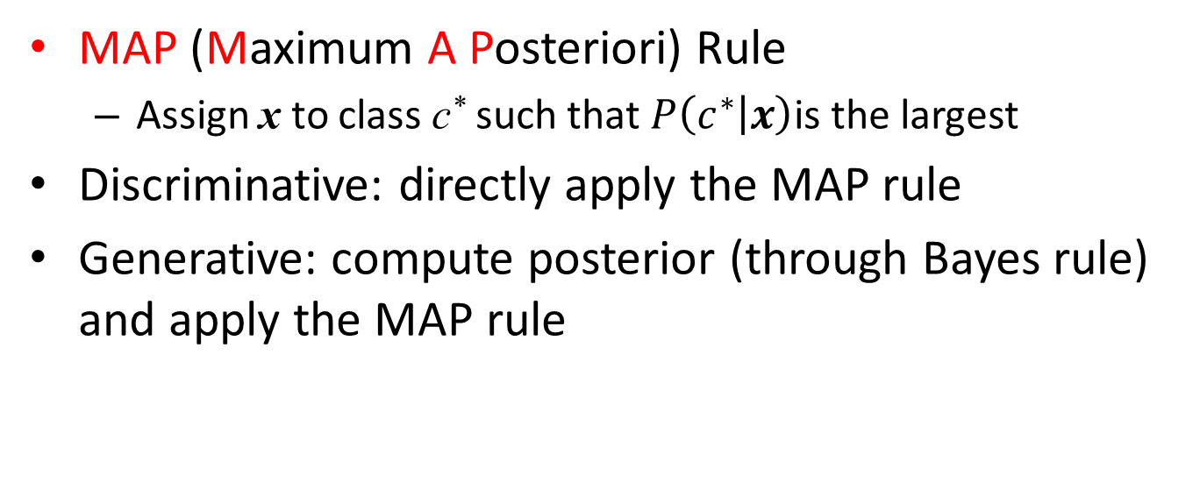
Probabilistic Classification Principle
MAP (Maximum A Posteriori) Rule
Assign x to class c* such that $P\left(c^{∗} | x\right)$is the largest
Discriminative: directly apply the MAP rule
Generative: compute posterior (through Bayes rule) and apply the MAP rule
$$P(c_{i}|x)∝P\left(c_{i}\right)P(x|c_{i})$$

Slide 8
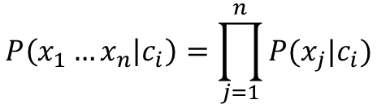
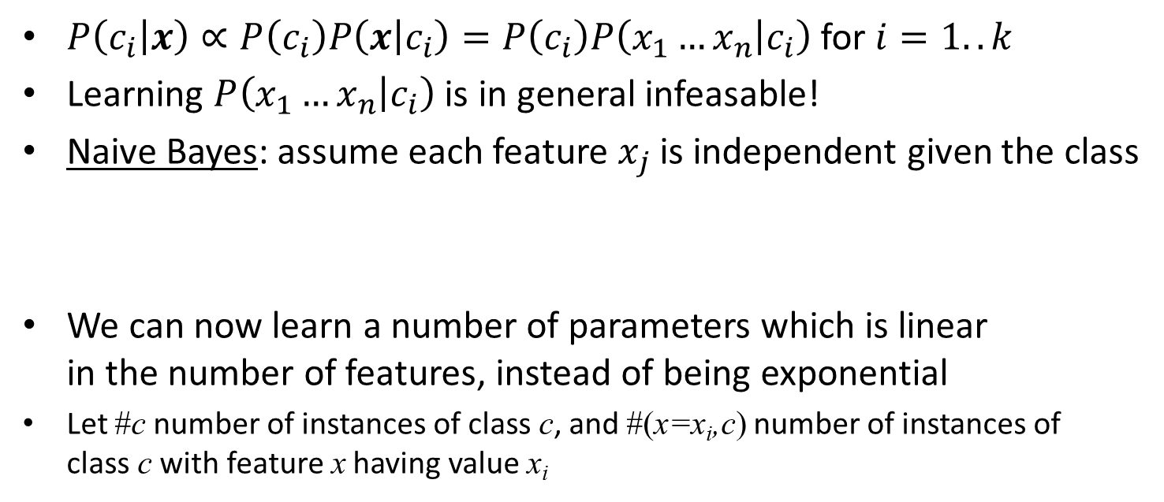
Naïve Bayes
$P\left(c_{i} | x\right)∝P\left(c_{i}\right)P\left(x | c_{i}\right)=P\left(c_{i}\right)P\left(x_{1}…x_{n} | c_{i}\right)$ for $i=1..k$
Learning $P\left(x_{1}…x_{n} | c_{i}\right)$ is in general infeasable!
Naive Bayes: assume each feature $x_{j}$ is independent given the class
We can now learn a number of parameters which is linear in the number of features, instead of being exponential
Let #c number of instances of class c, and #(x=x_{i},c) number of instances of class c with feature x having value x_{i}
$$P\left(x_{1}…x_{n} | c_{i}\right)=\prod_{j=1}^{n}{P(x_{j}|c_{i})}$$

Slide 9
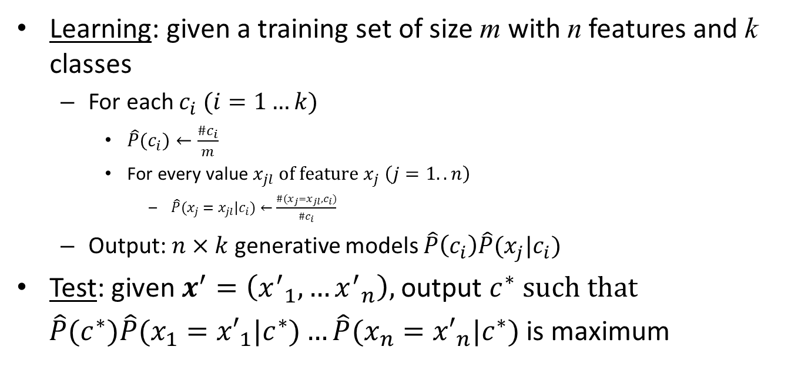
Naïve Bayes Algorithm (discrete features)
Learning: given a training set of size m with n features and k classes
For each $c_{i} (i=1…k)$
$\hat{P}(c_{i})←\frac{\#c_{i}}{m}$
For every value $x_{jl} \text{of} \text{feature} x_{j} \left(j=1..n\right)$
$\hat{P}(x_{j}=x_{jl}|c_{i})←\frac{\#(x_{j}=x_{jl},c_{i})}{\#c_{i}}$
Output: $n×k$ generative models $\hat{P}\left(c_{i}\right)\hat{P}(x_{j}|c_{i})$
Test: given $x^{′}=\left({x^{′}}_{1},…{x^{′}}_{n}\right),$ output $c^{∗} \text{such} \text{that}$
$\hat{P}(c^{∗})\hat{P}(x_{1}={x′}_{1}|c^{∗})…\hat{P}(x_{n}={x′}_{n}|c^{∗})$ is maximum

Slide 10
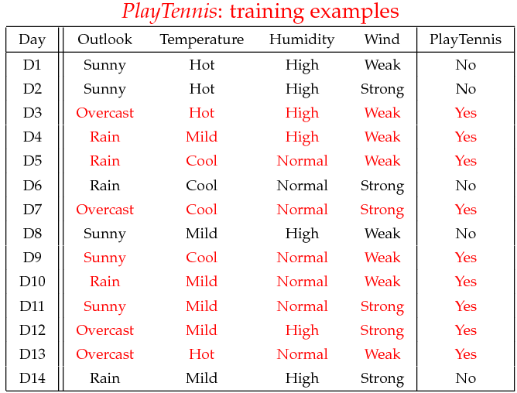
Example

Slide 11

Learning
$$\hat{P}(\text{Outlook}=Sunny|Yes)$$
Outlook | Play=Yes | Play=No
Sunny | 2/9 | 3/5
Overcast | 4/9 | 0/5
Rain | 3/9 | 2/5
Temperature | Play=Yes | Play=No
Hot | 2/9 | 2/5
Mild | 4/9 | 2/5
Cool | 3/9 | 1/5
Humidity | Play=Yes | Play=No
High | 3/9 | 4/5
Normal | 6/9 | 1/5
Wind | Play=Yes | Play=No
Strong | 3/9 | 3/5
Weak | 6/9 | 2/5
P(Play=Yes) = 9/14
P(Play=No) = 5/14

Slide 12
Test
Given a new instance x’, predict its label (Yes or No)
x’=(Outlook=Sunny, Temperature=Cool, Humidity=High, Wind=Strong)
Look up tables achieved in the learning phrase
Decision making with the MAP rule
P(Outlook=Sunny|Play=Yes) = 2/9
P(Temperature=Cool|Play=Yes) = 3/9
P(Huminity=High|Play=Yes) = 3/9
P(Wind=Strong|Play=Yes) = 3/9
P(Play=Yes) = 9/14
P(Outlook=Sunny|Play=No) = 3/5
P(Temperature=Cool|Play==No) = 1/5
P(Huminity=High|Play=No) = 4/5
P(Wind=Strong|Play=No) = 3/5
P(Play=No) = 5/14
P(Yes|x’) ≈ [P(Sunny|Yes)P(Cool|Yes)P(High|Yes)P(Strong|Yes)]P(Play=Yes) = 0.0053
P(No|x’) ≈ [P(Sunny|No) P(Cool|No)P(High|No)P(Strong|No)]P(Play=No) = 0.0206
Given the fact P(Yes|x’) < P(No|x’), we label x’ to be “No”.

Slide 13



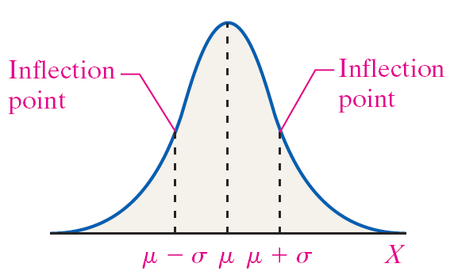
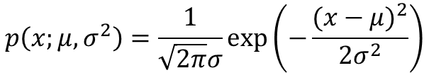
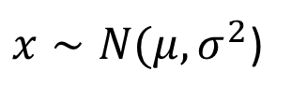
Gaussian (Normal) distribution
Say . If is a distributed Gaussian with mean , variance .
$x∼N(μ,σ^{2}$)
$$p\left(x;μ,σ^{2}\right)=\frac{1}{\sqrt{2π}σ}exp⁡\left(−\frac{{(x−μ)}^{2}}{2σ^{2}}\right)$$
Notes:
Add dots

Slide 14
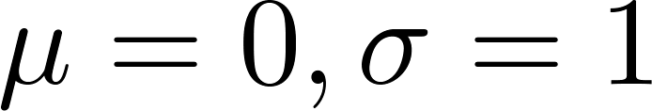
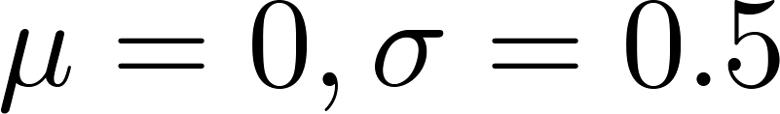
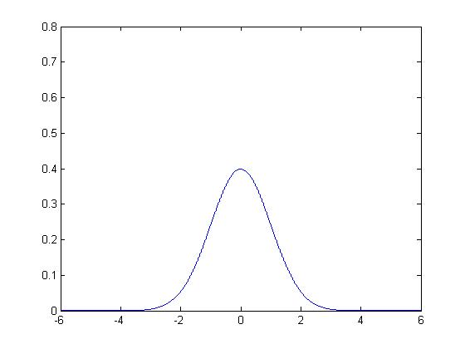
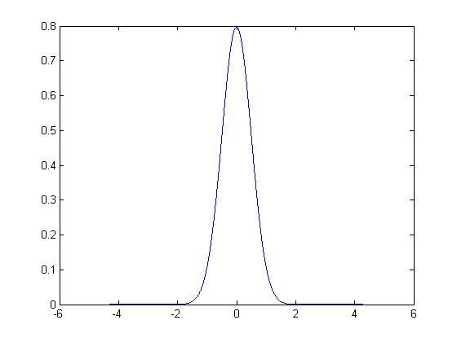
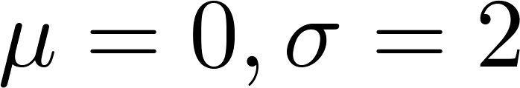
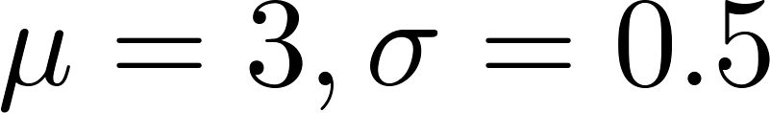
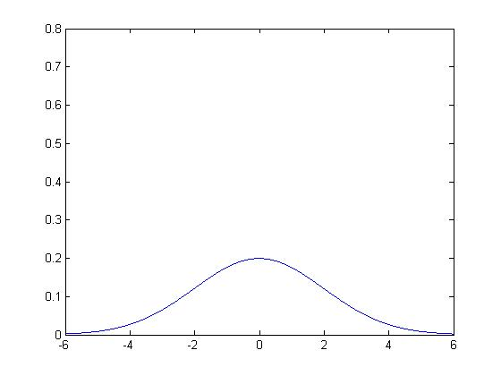
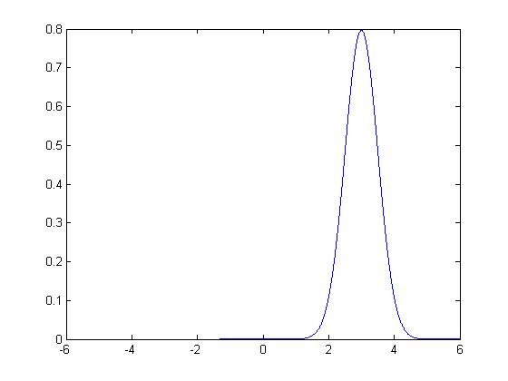
Gaussian distribution example

Slide 15
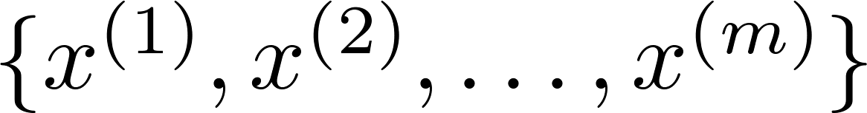
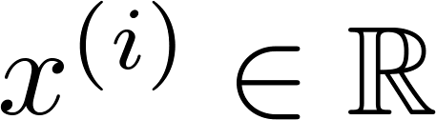
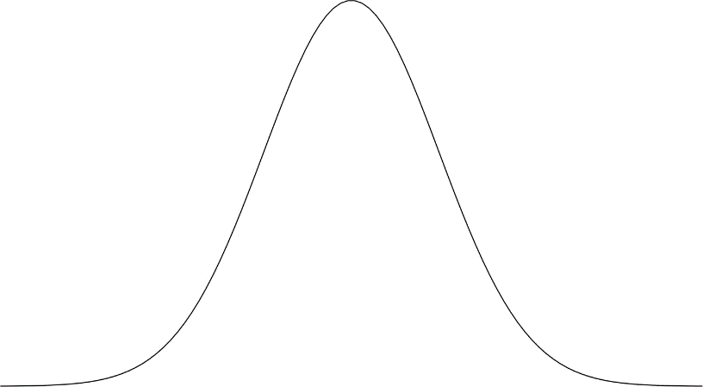
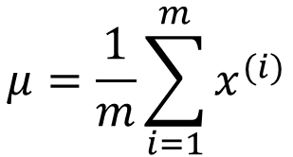

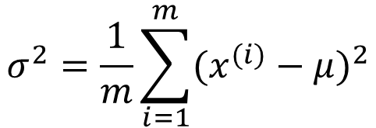
Parameter estimation
Dataset:
$$\text{Assumption}:x∼N(μ,σ^{2})$$
How we estimate μ and σ?
Sample mean and
Sample variance
$$μ=\frac{1}{m}\sum_{i=1}^{m}{x^{(i)}}$$
$$σ^{2}=\frac{1}{m}\sum_{i=1}^{m}{{(x^{(i)}−μ)}^{2}}$$
NB: for large m it is ok
this biased version

Slide 16
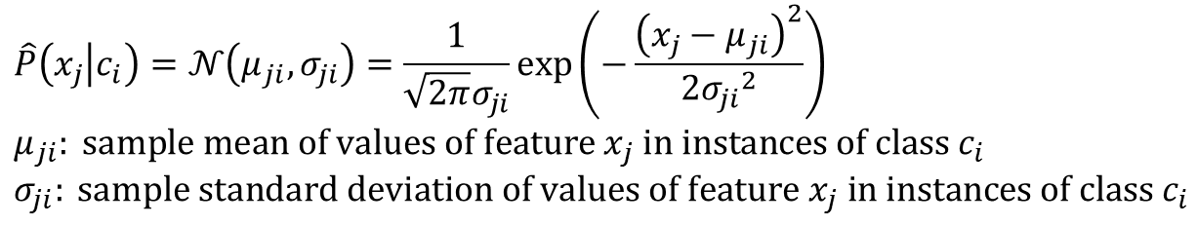
Naïve Bayes (continuous features)
Estimation of likelihoods by assuming normal distribution
Learning: estimate priors as before, and likelihoods as above
Continuous features will produce k normal (Gaussian) models (one for each class)
Testing is as in the discrete case (MAP rule)
$$\hat{P}\left(x_{j} | c_{i}\right)=𝒩\left(μ_{ji},σ_{ji}\right)=\frac{1}{\sqrt{2π}σ_{ji}}exp\left(−\frac{{\left(x_{j}−μ_{ji}\right)}^{2}}{2{σ_{ji}}^{2}}\right) \\ μ_{ji}: \text{sample} \text{mean} \text{of} \text{values} \text{of} \text{feature} x_{j} \text{in} \text{instances} \text{of} \text{class} c_{i} \\ σ_{ji}: \text{sample} \text{standard} \text{deviation} \text{of} \text{values} \text{of} \text{feature} x_{j} \text{in} \text{instances} \text{of} \text{class} c_{i}$$

Slide 17
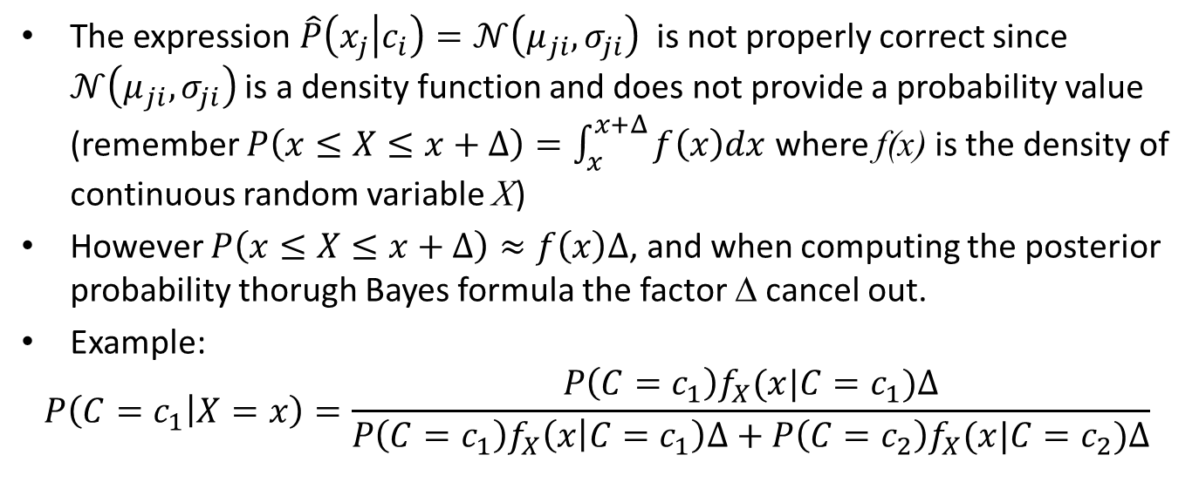
A little subtlety
The expression $\hat{P}\left(x_{j} | c_{i}\right)=𝒩\left(μ_{ji},σ_{ji}\right)$ is not properly correct since $𝒩\left(μ_{ji},σ_{ji}\right)$ is a density function and does not provide a probability value (remember $P\left(x≤X≤x+Δ\right)=\int_{x}^{x+Δ}{f\left(x\right)dx}$ where f(x) is the density of continuous random variable X)
However $P\left(x≤X≤x+Δ\right)≈f\left(x\right)Δ$, and when computing the posterior probability thorugh Bayes formula the factor Δ cancel out.
Example:
$$P\left(C=c_{1} | X=x\right)=\frac{P\left(C=c_{1}\right)f_{X}(x|C=c_{1})Δ}{P\left(C=c_{1}\right)f_{X}\left(x | C=c_{1}\right)Δ+P\left(C=c_{2}\right)f_{X}(x|C=c_{2})Δ}$$

Slide 18
Example: Continuous-valued Features
Temperature is naturally of continuous value.
Yes: 25.2, 19.3, 18.5, 21.7, 20.1, 24.3, 22.8, 23.1, 19.8
No: 27.3, 30.1, 17.4, 29.5, 15.1
Estimate mean and variance for each class
Learning Phase: output two Gaussian models for P(temp|c)

Slide 19

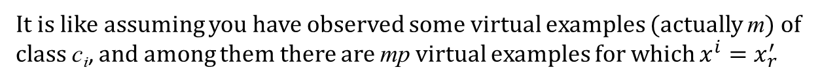
Zero conditional probability
If no example contains a feature value
In this circumstance, we face a zero conditional probability problem during test
For a remedy, class conditional probabilities re-estimated with
$\hat{P}\left(x_{1}^{′} | c_{i}\right)…\hat{P}\left(x_{r}^{′} | c_{i}\right)$…$\hat{P}\left(x_{n}^{′} | c_{i}\right)=0 \text{when} x_{j}=x_{r}^{′} \text{and} \hat{P}\left(x_{r}^{′} | c_{i}\right)=0$
$$\hat{P}\left(x_{r}^{′} | c_{i}\right)=\frac{\#(x^{′}=x_{r}^{′},c_{i})+mp}{\#c_{i}+m}$$
(m-estimate)
$$p \text{is} \text{a} \text{prior} \text{estimate} \text{of} \text{the} \text{conditional} \text{probability}\text{ (}\text{e}\text{.}\text{g}\text{. }\text{uniform} \text{over} \text{values}\text{)} \\ m \text{is} \text{an} \text{importance} \text{weight} \text{of} \text{the} \text{prior}\text{ (}\text{equivalent} \text{sample} \text{size} m≥1)$$
It is like assuming you have observed some virtual examples (actually m) of class c_{i}, and among them there are mp virtual examples for which $x^{i}=x_{r}^{′}$

Slide 20
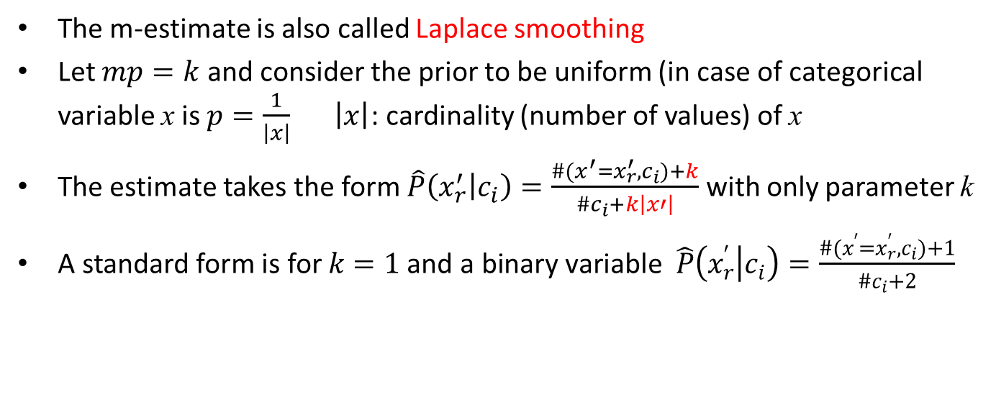
Supplementary
The m-estimate is also called Laplace smoothing
Let $mp=k$ and consider the prior to be uniform (in case of categorical variable x is $p=\frac{1}{\left|x\right|} \left|x\right|$: cardinality (number of values) of x
The estimate takes the form $\hat{P}\left(x_{r}^{′} | c_{i}\right)=\frac{\#(x^{′}=x_{r}^{′},c_{i})+k}{\#c_{i}+k\left|x′\right|}$ with only parameter k
A standard form is for $k=1 \text{and} \text{a} \text{binary} \text{variable} \hat{P}\left(x_{r}^{′} | c_{i}\right)=\frac{\#(x^{′}=x_{r}^{′},c_{i})+1}{\#c_{i}+2}$

Slide 21
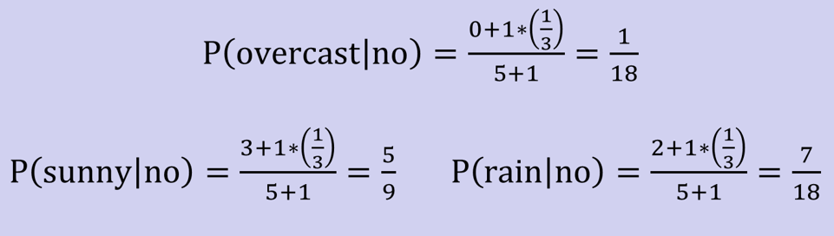
Example:
P(outlook=overcast|no)=0 in the play-tennis dataset
Adding m “virtual” examples (m: up to 1% of #training example)
In this dataset, # of training examples for the “no” class is 5.
We add m=1 “virtual” example in our m-estimate remedy.
The “outlook” feature can takes only 3 values. So p=1/3.
Re-estimate P(outlook|no) with the m-estimate

Slide 22
Naïve Bayes: summary
A popular generative model for classification
Performance competitive to most of state-of-the-art classifiers even in presence of violating independence assumption
Many successful applications, e.g., spam mail filtering
A good candidate of a base learner in ensemble learning (will see that)
Apart from classification, naïve Bayes can do more…

Slide 23
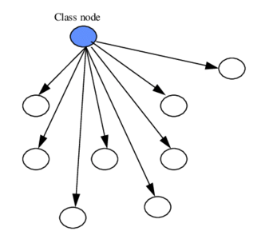
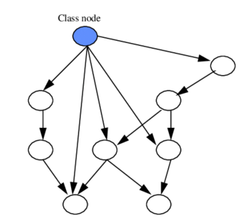
Beyond Naïve Bayes Bayesian Network Classifiers

